Slide 1
Unit 10: Graphs

Slide 2
CONTENTS
Introduction
Graphs as an ADT
Transitive Closure
Warshall's Algorithm
Types of Graph
Graph Traversal and Spanning Forests
Kruskal's and Round-Robin Algorithms
Shortest- path Algorithm
Greedy Algorithm
DijKstra's Algorithm

Slide 3
Graph:
Graph is a nonlinear data structure which consists of a set of points known as nodes (vertices) and set of links known as edges
A Graph is an ordered pair G = (V,E) where V denotes a set of vertices and E denotes the set of edges connecting two vertices.
Many natural problems can be explained using graph for example modeling road network, electronic circuits, etc.
The example below shows the road network.

Slide 4
Graph
Let us take a graph
V(G)={v1, v2, v3, v4, v5}
E(G)={(v1,v2),(v2,v3),(v1,v3),(v3,v4),(v4,v5)} a graph

Slide 5
Application of graphs
Graphs are used to model the geographic maps of the cities in which each place in the city can be represented by node and the road connecting such places are represented by edges
Graphs are used to model the computer networks
They are used to analyze the electrical circuits, project plannings

Slide 6
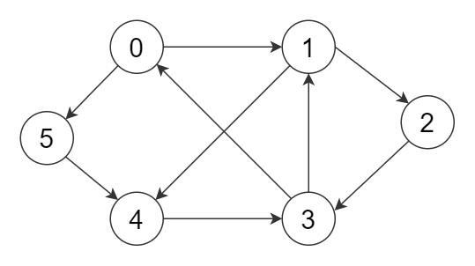
Types of graphs
Directed graphs
A directed graph consists of set of vertices and a set if directed edges E. A simple graph with directed flow is called directed graphs.

Slide 7
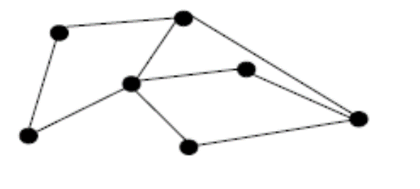
Directed and undirected graphs
Undirected graphs
An undirected graph (V,E) consists of a set V of vertices , a set E of edges that are ordered pairs of elements of V, where the edges have no directions.

Slide 8
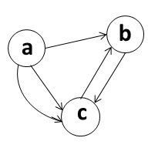
Directed multi graphs
A directed multi graph G=(V,E) consists of a set of vertices V, a set of edges E and a function f from E to {(u,v)|u,v €V}. The edges e1 and e2 are called multiple edges if f(e1)=f(e2).

Slide 9
Graph Terminology
Path- can be defined as the sequence of nodes that are followed in order to reach some terminal nodes.
Closed Path- Path is called as closed path if the initial node is same as terminal node
Adjacent Nodes- If two nodes u and v are connected via an edge e, then the nodes u and v are called as neighbors or adjacent nodes
Degree of Node- A degree of a node is the number of edges that are connected with that node.
Weighted graph – In the weighted graph each edge is assigned with some data such as length or weight.

Slide 10
Graph as an ADT
The graph abstract data type (ADT) is defined as follows
Graph()-creates a new graph
Addvertex()-adds an instance of vertex in graph
Addedge(from vert, to vert)- ads new , directed edges to the graph that connects two vertices
Addvertex(from vert, to vert, weight)- adds a new , weighted directed edge to the graph that connects two vertices
Getvertex(vertkey)-finds the vertex in the graph named vertkey
Getvertices()-returns the list of all vertices in the graph

Slide 11
Representation of Graph
Generally graph can be represented in two ways namely adjacency lists (Linked list representation) and adjacency matrix (matrix).
Adjacency List:
This type of representation is suitable for the undirected graphs without multiple edges, and directed graphs. This representation looks as in the tables below

Slide 13
Adjacency Matrix:
Given a simple graph G =(V, E) with |V| = n. assume that the vertices of the graph are listed in some arbitrary order like v1, v2, …, vn. The adjacency matrix A of G, with respect to the order of the vertices is n-by-n zero-one matrix (A = [aij]) with the condition,

Slide 14
Let the order of the vertices be a, b, c, d, e, f
 | A | B | C | D | E | F
A | 0 | 1 | 0 | 0 | 0 | 1
B | 1 | 0 | 1 | 1 | 1 | 1
C | 0 | 1 | 0 | 0 | 1 | 1
D | 0 | 1 | 0 | 0 | 1 | 0
E | 0 | 1 | 1 | 1 | 0 | 0
F | 1 | 1 | 1 | 0 | 0 | 0
Adjacency matrix

Slide 15
 | A | B | C | D | E | F | G | H
A | 0 | 0 | 1 | 0 | 0 | 0 | 0 | 0
B | 1 | 1 | 1 | 1 | 0 | 0 | 0 | 0
C | 0 | 0 | 0 | 1 | 1 | 0 | 0 | 0
D | 0 | 0 | 1 | 0 | 0 | 0 | 0 | 2
E | 0 | 0 | 0 | 0 | 1 | 1 | 0 | 0
F | 0 | 0 | 0 | 0 | 0 | 0 | 1 | 0
G | 0 | 0 | 0 | 0 | 0 | 1 | 0 | 0
H | 0 | 0 | 0 | 0 | 0 | 2 | 1 | 0

Slide 16
Graph traversals
Traversing graph means visiting all the nodes in the graph exactly once. There are two common approaches of traversal
Breadth first search traversal (BFS)
Depth first search traversal (DFS)

Slide 17
BFS traversal
Breadth-first search:
Choose some vertex arbitrarily as a root.
Add all the vertices and edges that are incident in the root.
The new vertices added will become the vertices at the level 1 of the BFS tree.
Find other vertices, such that they are connected by edges at level 1 vertices.
Follow the above step until all the vertices are added.

Slide 18
Use breadth first search to find a BFS tree of the following graph

Slide 19
Use breadth first search to find a BFS tree of the following graph

Slide 21
Depth First Search:
This is another technique that can be used to search the graph.
Choose a vertex as a root and form a path by starting at a root vertex by successively adding vertices and edges.
This process is continued until no possible path can be formed. If the path contains all the vertices then the tree consisting this path is DFS tree. Otherwise, we must add other edges and vertices.
For this move back from the last vertex that is met in the previous path and find whether it is possible to find new path starting from the vertex just met.
If there is such a path continue the process above.
If this cannot be done, move back to another vertex and repeat the process.
The whole process is continued until all the vertices are met.
This method of search is also called backtracking.

Slide 22
Use depth first search to find a spanning tree of the following graph.

Slide 26
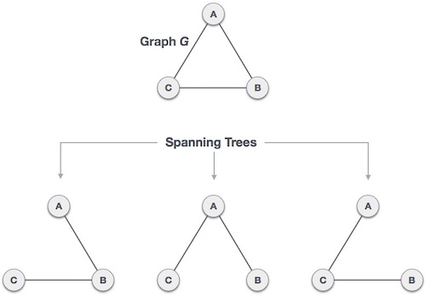
Spanning tree
A spanning tree is a subset of Graph G, which has all the vertices covered with minimum possible number of edges. Hence, a spanning tree does not have cycles and it cannot be disconnected..
By this definition, we can draw a conclusion that every connected and undirected Graph G has at least one spanning tree.
A disconnected graph does not have any spanning tree, as it cannot be spanned to all its vertices

Slide 27
We found three spanning trees off one complete graph. A complete undirected graph can have maximum n^{n-2} number of spanning trees, where n is the number of nodes. In the above addressed example, n is 3, hence 3³⁻² = 3 spanning trees are possible.

Slide 28
General Properties of Spanning Tree
The following are a few properties of the spanning tree connected to graph G −
A connected graph G can have more than one spanning tree.
All possible spanning trees of graph G, have the same number of edges and vertices.
The spanning tree does not have any cycle (loops).
Removing one edge from the spanning tree will make the graph disconnected, i.e. the spanning tree is minimally connected.
Adding one edge to the spanning tree will create a circuit or loop, i.e. the spanning tree is maximally acyclic

Slide 29
Minimum Spanning Tree (MST)
In a weighted graph, a minimum spanning tree is a spanning tree that has minimum weight than all other spanning trees of the same graph.
In real-world situations, this weight can be measured as distance, congestion, traffic load or any arbitrary value denoted to the edges.

Slide 30
Minimum spanning tree
Find the MST of the given graph
4
1
Solution
2
4
1
4
1
T3
T1
T2
Total weight of T1=6
Total weight of T2=5
Total weight of T3=3
So the T3 is the minimum spanning tree
2
2

Slide 31
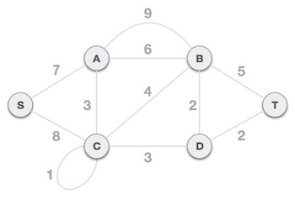
Kruskal Algorithm
kruskal algorithm is a minimum spanning tree algorithm that takes a graph as an input and finds the subset of edges.
This algorithm treats the graph as a forest and every node it has as an individual tree.
A tree connects to another only and only if, it has the least cost among all available options and does not violate minimum spanning tree (MST) properties.

Slide 32
Algorithm
Start
Sort all the edges from low weight to high
Take the edge with the lowest weight and add it to the spanning tree. If adding the edge created a cycle then reject this edge.
Keep adding edges until we reach all vertices
Stop

Slide 33
Example

Slide 34
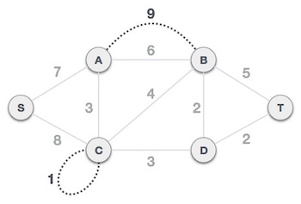
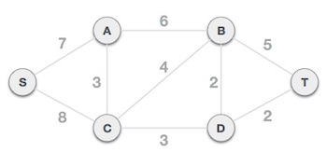
Step 1 - Remove all loops and Parallel Edges
Remove all loops and parallel edges from the given graph.

Slide 35

Step 2 - Arrange all edges in their increasing order of weight
The next step is to create a set of edges and weight, and arrange them in an ascending order of weightage (cost).

Slide 36
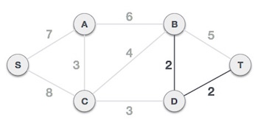
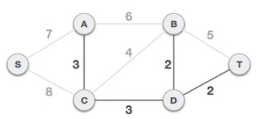

Slide 37
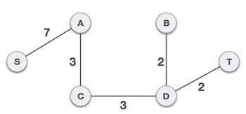

Slide 38
Prims algorithm
Prim's algorithm to find minimum cost spanning tree (as Kruskal's algorithm) uses the greedy approach.
Prim's algorithm shares a similarity with the shortest path first algorithms.
Prim's algorithm, in contrast with Kruskal's algorithm, treats the nodes as a single tree and keeps on adding new nodes to the spanning tree from the given graph.

Slide 39
Example

Slide 40
Step 1 - Remove all loops and parallel edges

Slide 41
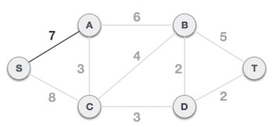
Choose any arbitrary node as root node
After choosing the root node S, we see that S,A and S,C are two edges with weight 7 and 8, respectively. We choose the edge S,A as it is lesser than the other.

Slide 42
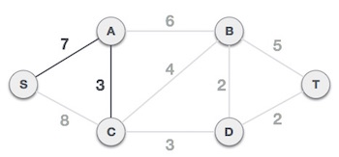
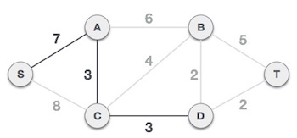
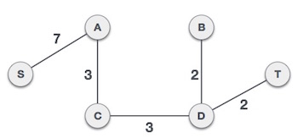
Next

Slide 43
Dijkstra Algorithm
The Dijkstra’s algorithm finds the shortest path from a particular node, called the source node to every other node in a connected graph.
It produces a shortest path tree with the source node as the root.
It is profoundly used in computer networks to generate optimal routes with the aim of minimizing routing costs.
Input − A graph representing the network; and a source node, s
Output − A shortest path tree, spt[], with s as the root node.

Slide 44
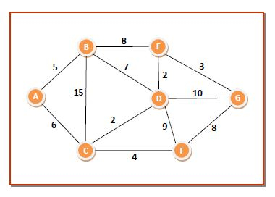
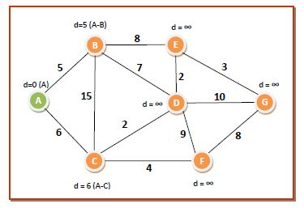
Example
The initializations will be as follows −
dist[7]={0,∞,∞,∞,∞,∞,∞}
Q={A,B,C,D,E,F,G}
We choose node A from Q . The neighboring nodes of A are B and C. We update dist[] values corresponding to B and C according to the algorithm. So the values of the data structures become −
dist[7]={0,5,6,∞,∞,∞,∞}
Q={B,C,D,E,F,G}

Slide 45
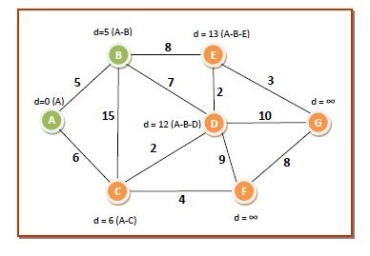
Dijkstra Contd….
We choose node B from Q since it has the lowest dist[] value of 5 and put it in S. The neighbouring nodes of B are C, D and E. We update dist[] values corresponding to C, D and E according to the algorithm. So the values of the data structures become −
dist[7]={0,5,6,12,13,∞,∞}
Q={C,D,E,F,G}

Slide 46
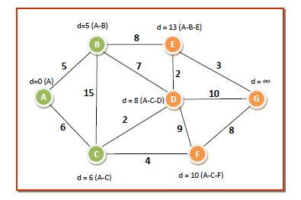
We choose node C from Q since it has the lowest dist[] value of 6 and put it in S. The neighbouring nodes of C are D and F. We update dist[] values corresponding to D and F. So the values of the data structures become −
dist[7]={0,5,6,8,13,10,∞}
Q={D,E,F,G}

Slide 47
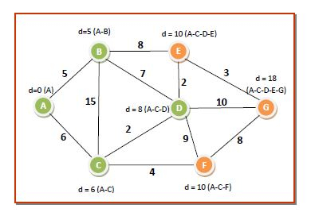
We choose node D from Q since it has the lowest dist[] value of 8 and put it in S. The neighbouring nodes of D are E, F and G. We update dist[] values corresponding to E, F and G. So the values of the data structures become −
dist[7]={0,5,6,8,10,10,18}
Q={E,F,G}
S={A,B,C,D}

Slide 48
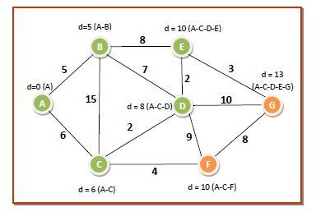
We can choose either node E or node F from Q since both of them have the lowest dist[] value of 10. We select any one of them, say E, and put it in S. The neighbouring nodes of D is G. We update dist[] values corresponding to G. So the values of the data structures become −
dist[7]={0,5,6,8,10,10,13}
Q={F,G}
S={A,B,C,D,E}

Slide 49
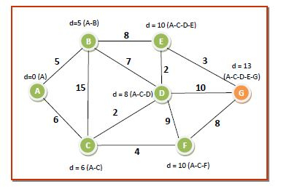
We choose node F from Q since it has the lowest dist[] value of 10 and put it in S. The neighbouring nodes of F is G. The dist[] value corresponding to G is less than that through F. So it remains same. The values of the data structures become −
dist[7]={0,5,6,8,10,10,13}
Q={G}
S={A,B,C,D,E,F}

Slide 50
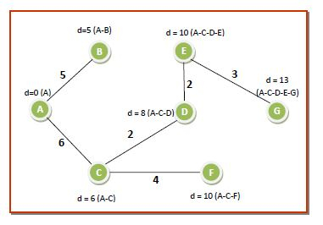
There is just one node in Q. We remove it from Q put it in S. The dist[] array needs no change. Now, Q becomes empty, S contains all the nodes and so we come to the end of the algorithm. We eliminate all the edges or routes that are not in the path of any route. So the shortest path tree from source node A to all other nodes are as follows −

Slide 51
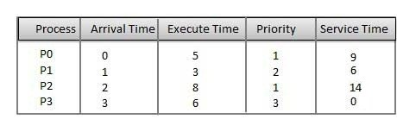
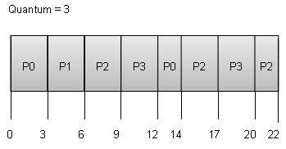
Round Robin Scheduling
Round Robin is the preemptive process scheduling algorithm.
Each process is provided a fix time to execute, it is called a quantum.
Once a process is executed for a given time period, it is preempted and other process executes for a given time period.
Context switching is used to save states of preempted processes.

Slide 52
Process | Wait Time : Service Time - Arrival Time
P0 | (0 - 0) + (12 - 3) = 9
P1 | (3 - 1) = 2
P2 | (6 - 2) + (14 - 9) + (20 - 17) = 12
P3 | (9 - 3) + (17 - 12) = 11
Wait time of each process is as follows −
Average Wait Time: (9+2+12+11) / 4 = 8.5

Slide 53
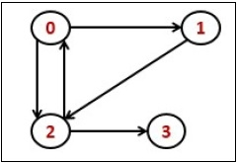
Transitive Closure
Transitive Closure it the reachability matrix to reach from vertex u to vertex v of a graph. One graph is given, we have to find a vertex v which is reachable from another vertex u, for all vertex pairs (u, v).

Slide 54
Warshall's algorithm
Warshall's algorithm calculates the transitive closure by generating a sequence of n matrices, where n is the number of vertices.
R⁽⁰⁾, ..., R^{(k-1)}, R^{(k)}, ... , R^{(n)}
The R⁽⁰⁾ matrix represent paths without any intermediate vertices, so it is the adjacency matrix. The R^{(n)} matrix has ones if there is a path between the vertices with intermediate vertices from any of the n vertices of the graph, so it is the transitive closure.
Consider the case r_{ij}^{(k)} is one and r_{ij}^{(k-1)} = 0. This can occur only if that there is an intermediate path through v_{k} from from v_{i} to v_{j}. More specifically the list of vertices has the form
v_{i}, w_{q} (where 1 ≤ q < k), v_{k}. w_{q} (where 1 ≤ q < k), v_{j}
This can happen only if r_{ik}^{(k-1)} = r_{kj}^{(k-1)} = 1. Note the k subscript
If r_{ij}^{(k-1)} = 1 then r_{ij}^{(k)} should be one.
In sumarry
r_{ij}^{(k)} = r_{ij}^{(k-1)} or (r_{ik}^{(k-1)} and r_{kj}^{(k-1)})

Slide 55
Warshall Algorithm
Algorithm Warshall(A[1...n, 1...n]) // A is the adjacency matrix
R⁽⁰⁾ ← A
for k ← 1 to n do
for i ← 1 to n do
for j ← to n do
R^{(k)}[i, j] ← R^{(k-1)}[i, j] or (R^{(k-1)}[i, k] and R^{(k-1)}[k, j])
return R^{(n)}

